Slide 1
PUBLIC KEY CRYPTOGRAPHY
Module-III

Slide 2
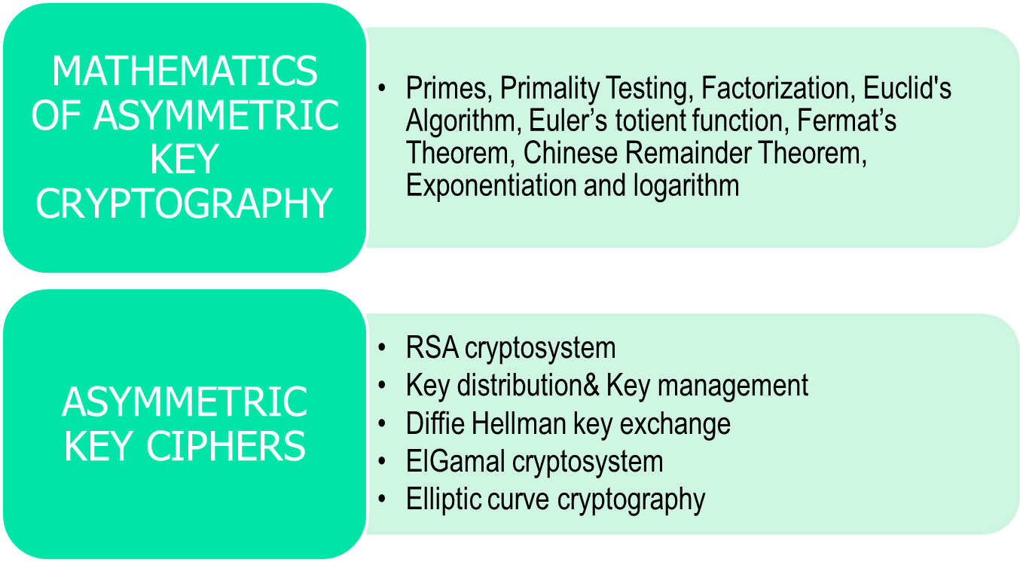
PUBLIC KEY CRYPTOGRAPHY
2.<number>

Slide 3
Chapter 2
Objectives
To review integer arithmetic, concentrating on divisibility
and finding the greatest common divisor using the Euclidean
algorithm
To understand how the extended Euclidean algorithm can be
used to solve linear congruent equations, and to find the multiplicative inverses
To emphasize the importance of modular arithmetic and
the modulo operator, because they are extensively used in
cryptography
To emphasize and review matrices and operations on residue
matrices that are extensively used in cryptography
To solve a set of congruent equations using residue matrices
2.<number>

Slide 4

Part-I
Mathematics of Cryptography
Modular Arithmetic, Congruence,
and Matrices

Slide 5
2-1 INTEGER ARITHMETIC
In integer arithmetic, we use a set and a few operations. You are familiar with this set and the corresponding operations, but they are reviewed here to create a background for modular arithmetic.
Topics discussed in this section:
2.1.1 Set of Integers
2.1.2 Binary Operations
2.1.3 Integer Division
2.1.4 Divisibility
2.1.5 Linear Diophantine Equations
2.<number>

Slide 6

2.1.1 Set of Integers
The set of integers, denoted by Z, contains all integral numbers (with no fraction) from negative infinity to positive infinity (Figure 2.1).
Figure 2.1 The set of integers
2.<number>

Slide 7
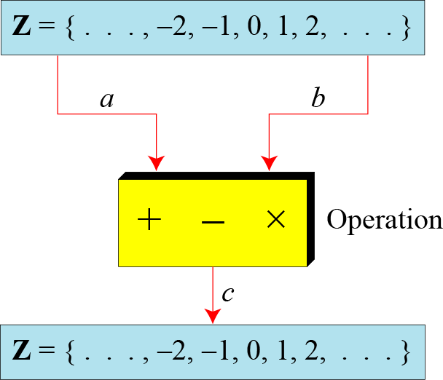
2.1.2 Binary Operations
In cryptography, we are interested in three binary operations applied to the set of integers. A binary operation takes two inputs and creates one output.
Figure 2.2 Three binary operations for the set of integers
2.<number>

Slide 8
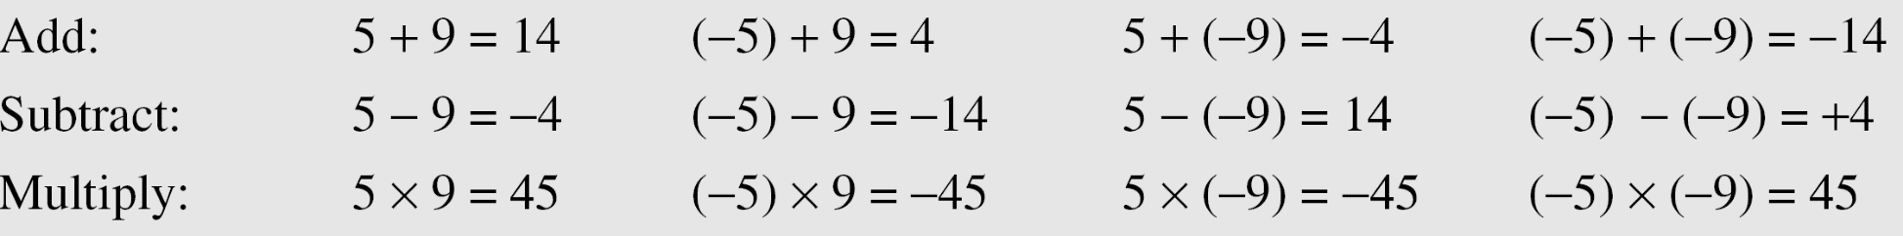
2.1.2 Continued
Example 2.1
The following shows the results of the three binary operations on two integers. Because each input can be either positive or negative, we can have four cases for each operation.
2.<number>

Slide 9
2.1.3 Integer Division
In integer arithmetic, if we divide a by n, we can get q
And r . The relationship between these four integers can be shown as
a = q × n + r
2.<number>

Slide 10
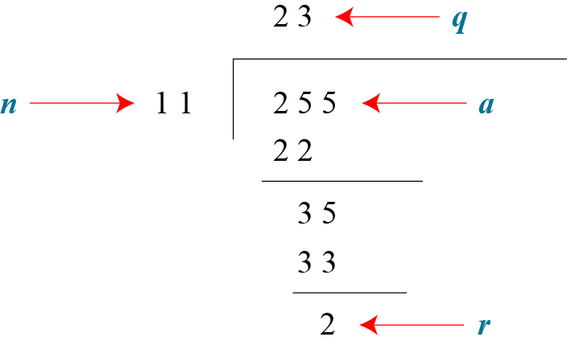
2.1.3 Continued
Example 2.2
Assume that a = 255 and n = 11. We can find q = 23 and R = 2 using the division algorithm.
Figure 2.3 Example 2.2, finding the quotient and the remainder
2.<number>

Slide 11
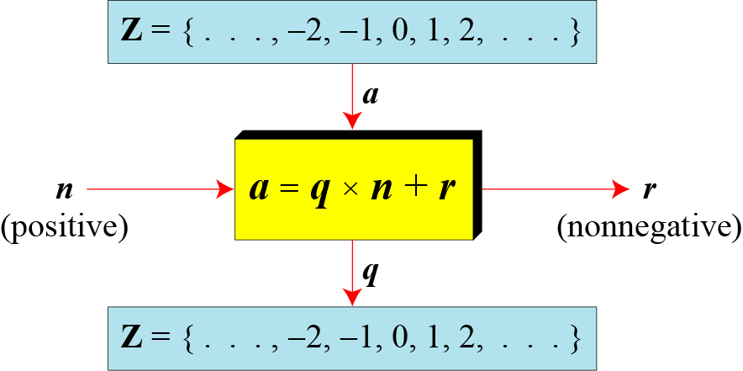
2.1.3 Continued
Figure 2.4 Division algorithm for integers
2.<number>

Slide 12
2.1.3 Continued
Example 2.3
When we use a computer or a calculator, r and q are negative when a is negative. How can we apply the restriction that r needs to be positive? The solution is simple, we decrement the value of q by 1 and we add the value of n to r to make it positive.
2.<number>

Slide 13

2.1.4 Continued
Note
Fact 1: The integer 1 has only one
divisor, itself.
Fact 2: Any positive integer has at least
two divisors, 1 and itself (but it
can have more).
2.<number>

Slide 14
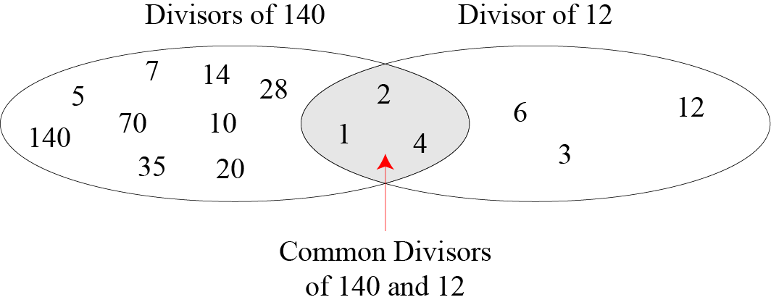
2.1.4 Continued
Figure 2.6 Common divisors of two integers
2.<number>

Slide 15
2.1.4 Continued
Note
Greatest Common Divisor
The greatest common divisor of two positive integers is the largest integer that can divide both integers.
Note
Euclidean Algorithm
Fact 1: gcd (a, 0) = a
Fact 2: gcd (a, b) = gcd (b, r), where r is
the remainder of dividing a by b
2.<number>

Slide 16
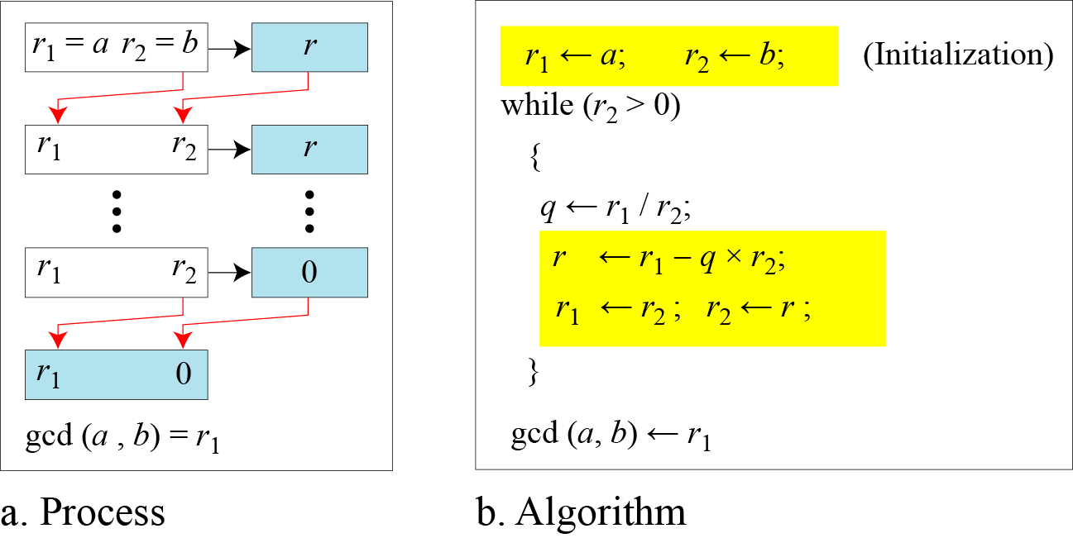
2.1.4 Continued
Figure 2.7 Euclidean Algorithm
Note
When gcd (a, b) = 1, we say that a and b are relatively prime.
2.<number>

Slide 17
2.1.4 Continued
Note
When gcd (a, b) = 1, we say that a and b are relatively prime.
2.<number>

Slide 18
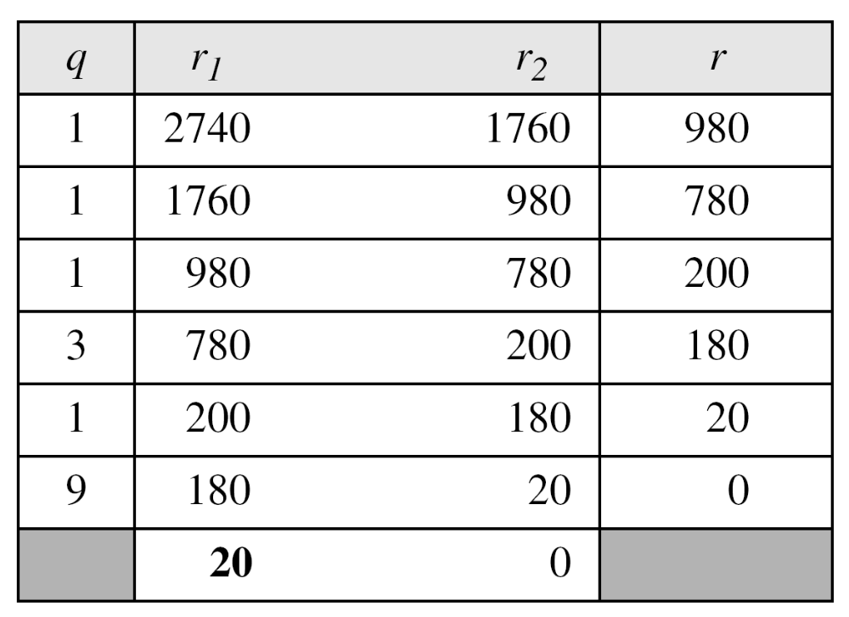
2.1.4 Continued
Example 2.7
Find the greatest common divisor of 2740 and 1760.
Solution
We have gcd (2740, 1760) = 20.
2.<number>

Slide 19
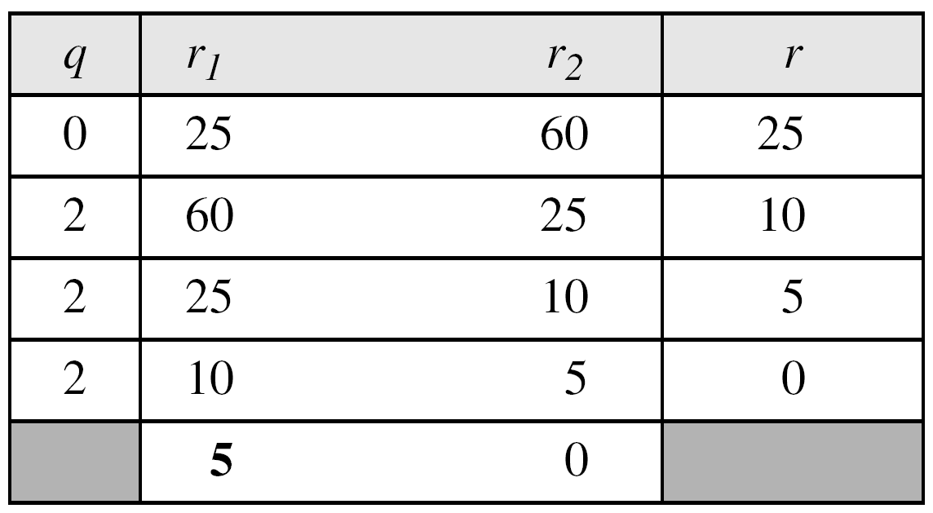
2.1.4 Continued
Example 2.8
Find the greatest common divisor of 25 and 60.
Solution
We have gcd (25, 60) = 5.
2.<number>

Slide 20

2.1.4 Continued
Extended Euclidean Algorithm
Given two integers a and b, we often need to find other two integers, s and t, such that
The extended Euclidean algorithm can calculate the gcd (a, b) and at the same time calculate the value of s and t.
2.<number>

Slide 21
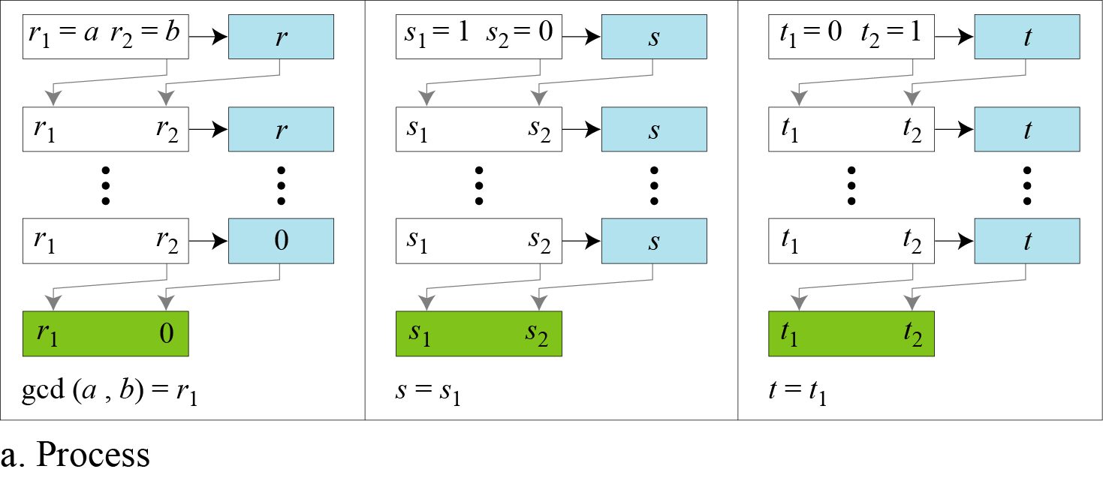
2.1.4 Continued
Figure 2.8.a Extended Euclidean algorithm, part a
2.<number>

Slide 22
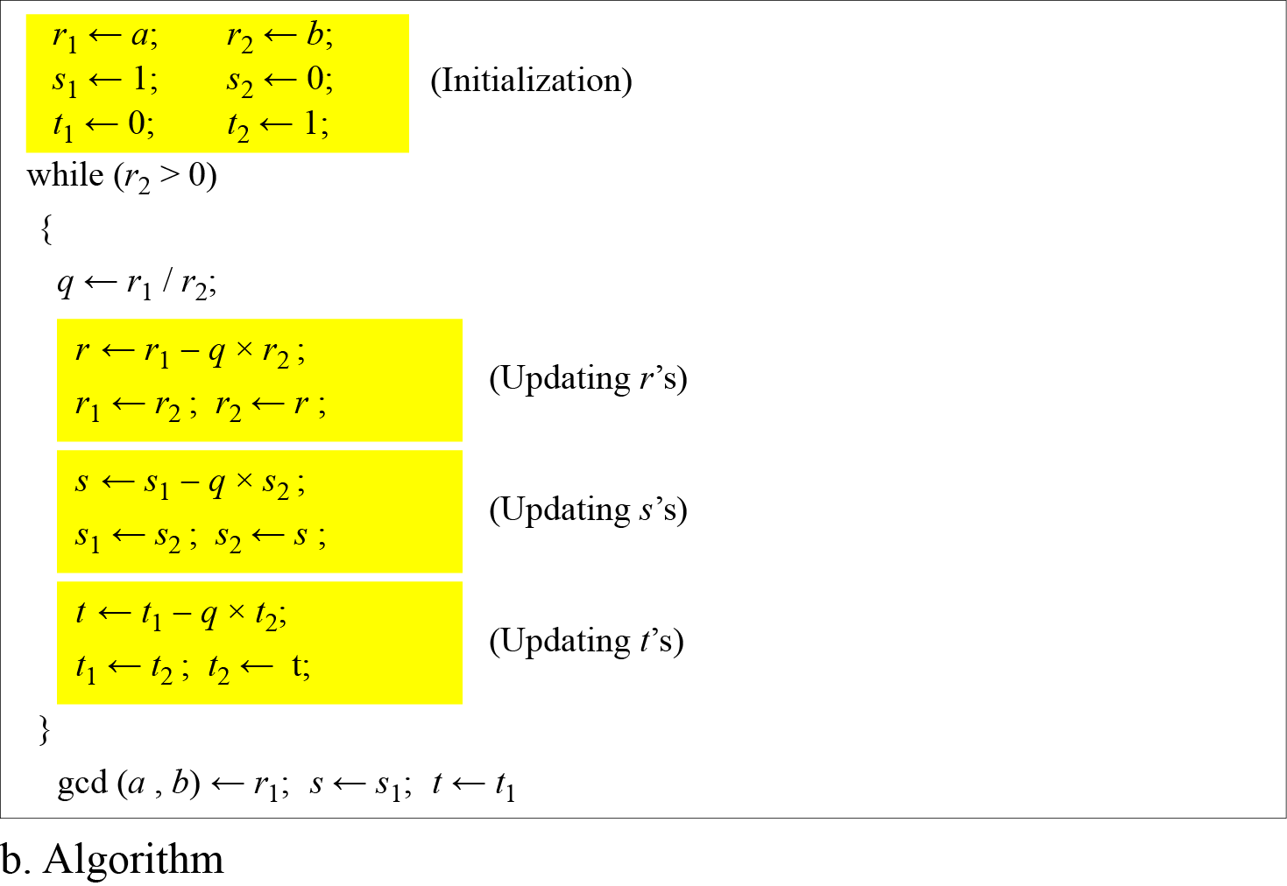
2.1.4 Continued
Figure 2.8.b Extended Euclidean algorithm, part b
2.<number>

Slide 23
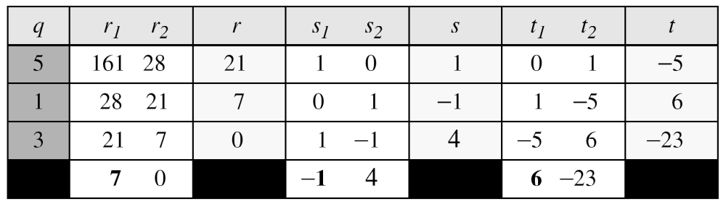
2.1.4 Continued
Example 2.9
Given a = 161 and b = 28, find gcd (a, b) and the values of s and t.
Solution
We get gcd (161, 28) = 7, s = −1 and t = 6.
2.<number>

Slide 24
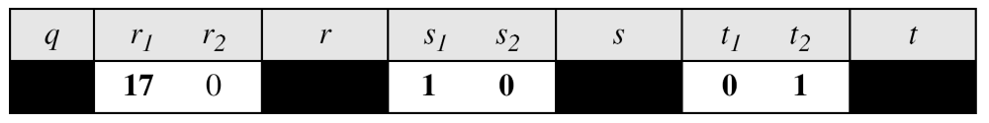
2.1.4 Continued
Example 2.10
Given a = 17 and b = 0, find gcd (a, b) and the values of s
and t.
Solution
We get gcd (17, 0) = 17, s = 1, and t = 0.
2.<number>

Slide 25
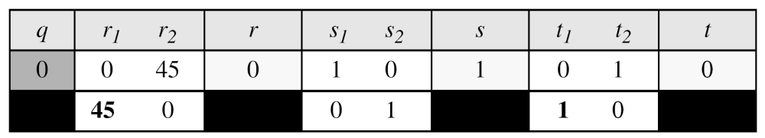
2.1.4 Continued
Example 2.11
Given a = 0 and b = 45, find gcd (a, b) and the values of s
and t.
Solution
We get gcd (0, 45) = 45, s = 0, and t = 1.
2.<number>

Slide 26
2-2 MODULAR ARITHMETIC
The division relationship (a = q × n + r) discussed in the previous section has two inputs (a and n) and two outputs (q and r). In modular arithmetic, we are interested in only one of the outputs, the remainder r.
Topics discussed in this section:
2.2.1 Modular Operator
2.2.2 Set of Residues
2.2.3 Congruence
2.2.4 Operations in Z_{n}
2.2.5 Addition and Multiplication Tables
2.2.6 Different Sets
2.<number>

Slide 27
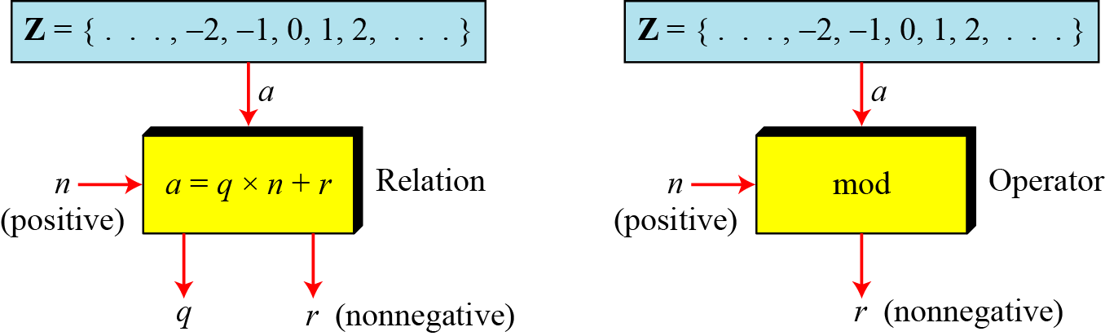
2.2.1 Modulo Operator
The modulo operator is shown as mod. The second input (n) is called the modulus. The output r is called the residue.
Figure 2.9 Division algorithm and modulo operator
2.<number>

Slide 28
2.1.4 Continued
Example 2.14
Find the result of the following operations:
a. 27 mod 5 b. 36 mod 12
c. −18 mod 14 d. −7 mod 10
Solution
Dividing 27 by 5 results in r = 2
Dividing 36 by 12 results in r = 0.
c. Dividing −18 by 14 results in r = −4. After adding the modulus r = 10
d. Dividing −7 by 10 results in r = −7. After adding the modulus to −7, r = 3.
2.<number>

Slide 29
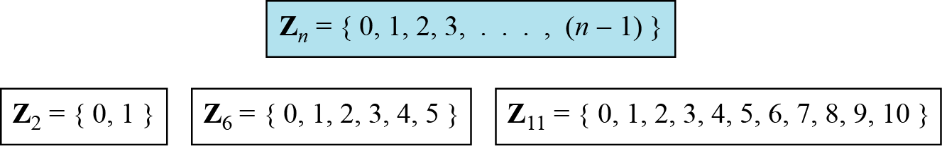
2.2.2 Set of Residues
The modulo operation creates a set, which in modular arithmetic is referred to as the set of least residues modulo n, or Z_{n}.
Figure 2.10 Some Z_{n} sets
2.<number>

Slide 30
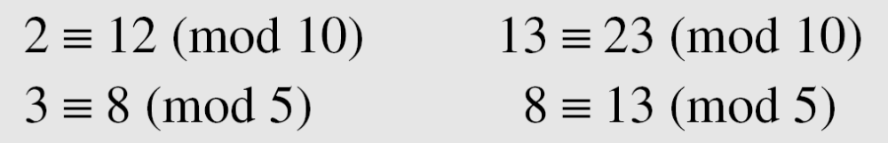
2.2.3 Congruence
To show that two integers are congruent, we use the congruence operator ( ≡ ). For example, we write:
2.<number>

Slide 31
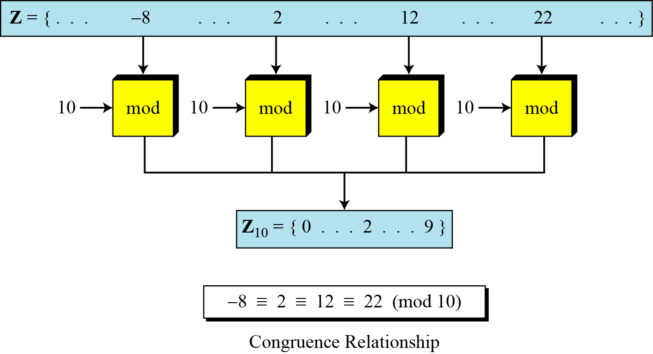
2.2.3 Continued
Figure 2.11 Concept of congruence
2.<number>

Slide 32
2.2.3 Continued
Example 2.15
We use modular arithmetic in our daily life; for example, we use a clock to measure time. Our clock system uses modulo 12 arithmetic. However, instead of a 0 we use the number 12.
2.<number>

Slide 33
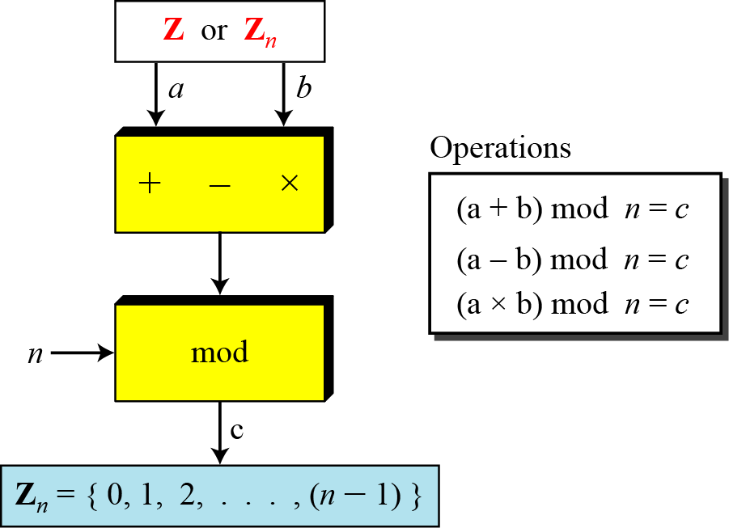
2.2.4 Operation in Z_{n}
The three binary operations that we discussed for the set Z can also be defined for the set Zn. The result may need to be mapped to Zn using the mod operator.
Figure 2.13 Binary operations in Z_{n}
2.<number>

Slide 34
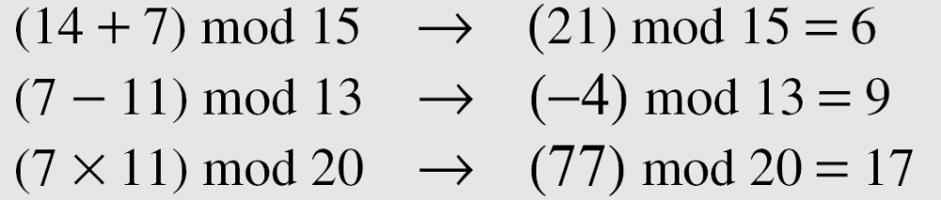
2.2.4 Continued
Example 2.16
Perform the following operations (the inputs come from Zn):
a. Add 7 to 14 in Z15.
b. Subtract 11 from 7 in Z13.
c. Multiply 11 by 7 in Z20.
Solution
2.<number>

Slide 35
2.2.4 Continued
Example 2.17
Perform the following operations (the inputs come from either Z or Z_{n}):
a. Add 17 to 27 in Z₁₄.
b. Subtract 43 from 12 in Z₁₃.
c. Multiply 123 by −10 in Z₁₉.
Solution
2.<number>

Slide 36
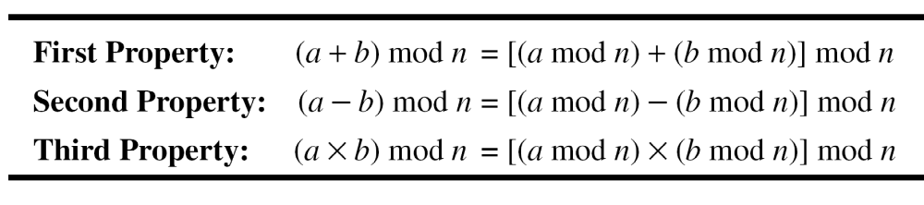
2.2.4 Continued
Properties
2.<number>

Slide 37
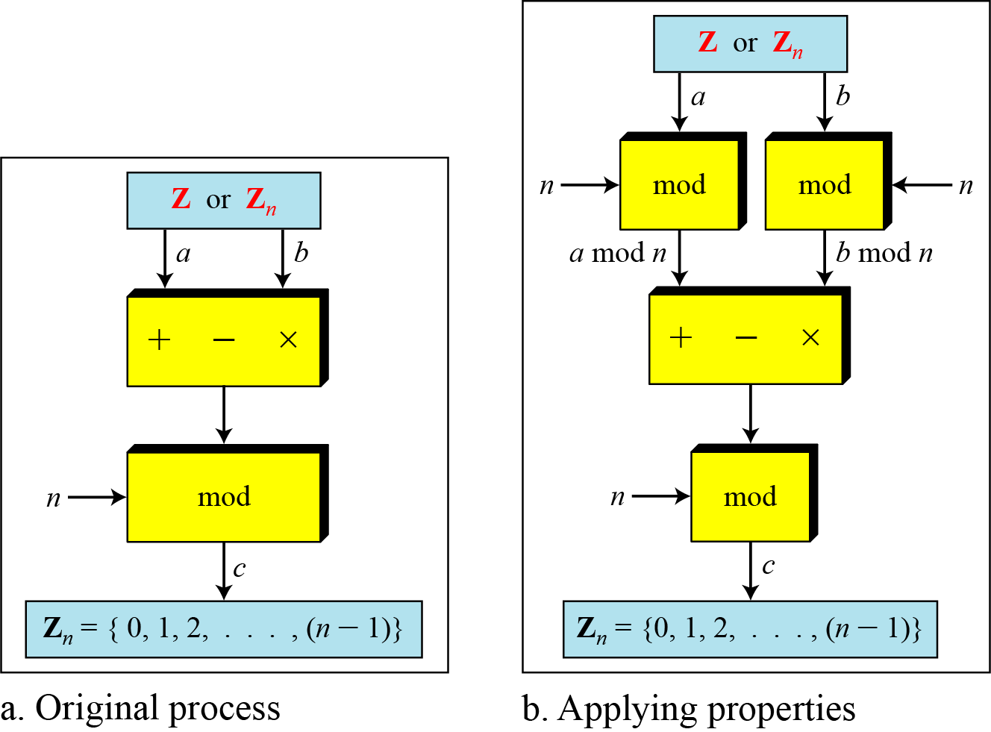
2.2.4 Continued
Figure 2.14 Properties of mode operator
2.<number>

Slide 38
2.2.4 Continued
Example 2.18
The following shows the application of the above properties:
1. (1,723,345 + 2,124,945) mod 11 = (8 + 9) mod 11 = 6
2. (1,723,345 − 2,124,945) mod 16 = (8 − 9) mod 11 = 10
3. (1,723,345 × 2,124,945) mod 16 = (8 × 9) mod 11 = 6
2.<number>

Slide 39

2.2.5 Continue
Multiplicative Inverse
In Z_{n}, two numbers a and b are the multiplicative inverse of each other if
Note
In modular arithmetic, an integer may or may not have a multiplicative inverse.
When it does, the product of the integer and its multiplicative inverse is congruent to 1 modulo n.
2.<number>

Slide 40
2.2.2 Set of Residues
The modulo operation creates a set, which in modular arithmetic is referred to as the set of least residues modulo n, or Z_{n}.
Figure 2.10 Some Z_{n} sets
2.<number>

Slide 41
2.2.5 Continued
Example 2.22
Find the multiplicative inverse of 8 in Z₁₀.
Solution
There is no multiplicative inverse because gcd (10, 8) = 2 ≠ 1. In other words, we cannot find any number between 0 and 9 such that when multiplied by 8, the result is congruent to 1.
Example 2.23
Find all multiplicative inverses in Z₁₀.
2.<number>

Slide 42
Solution
There are only three pairs: (1, 1), (3, 7) and (9, 9). The numbers 0, 2, 4, 5, 6, and 8 do not have a multiplicative inverse.
2.<number>

Slide 43
2.2.5 Continued
Example 2.24
Find all multiplicative inverse pairs in Z₁₁.
2.<number>

Slide 44
Solution
We have seven pairs: (1, 1), (2, 6), (3, 4), (5, 9), (7, 8), (9, 9), and (10, 10).
2.<number>

Slide 45
2.2.5 Continued
Note
The extended Euclidean algorithm finds the multiplicative inverses of b in Z_{n} when n and b are given and
gcd (n, b) = 1.
The multiplicative inverse of b is the value of t after being mapped to Z_{n}.
2.<number>

Slide 46
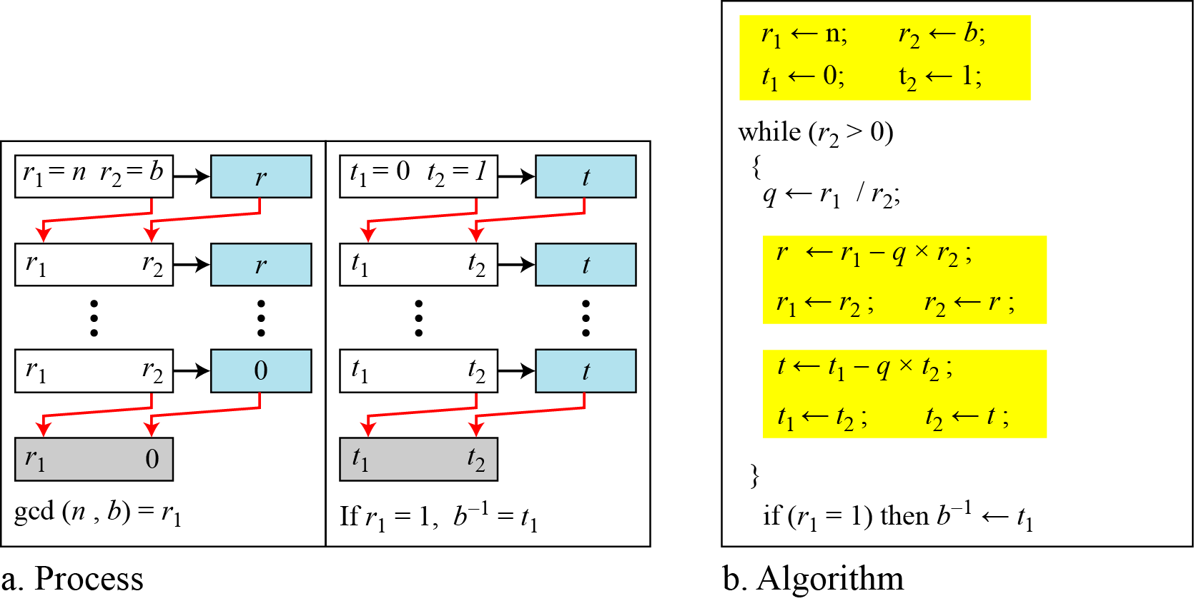
2.2.5 Continued
Figure 2.15 Using extended Euclidean algorithm to
find multiplicative inverse
2.<number>

Slide 47
2.2.5 Continued
Example 2.25
Find the multiplicative inverse of 11 in Z₂₆.
2.<number>

Slide 48
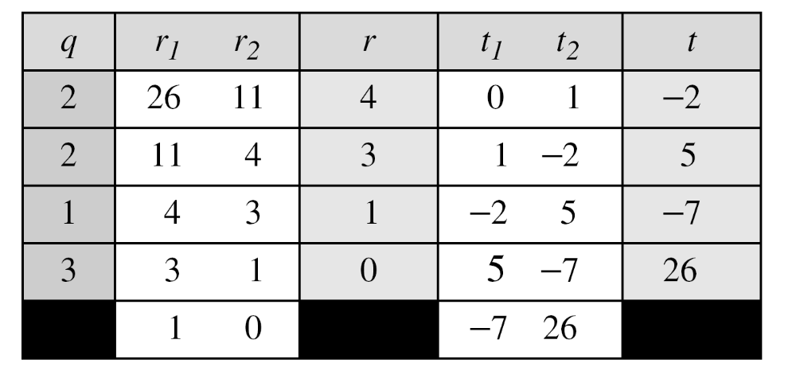
Find the multiplicative inverse of 11 in Z₂₆.
Solution
The gcd (26, 11) is 1; the inverse of 11 is −7 or 19.
2.<number>

Slide 49
2.2.5 Continued
Example 2.26
Find the multiplicative inverse of 23 in Z₁₀₀.
2.<number>

Slide 50
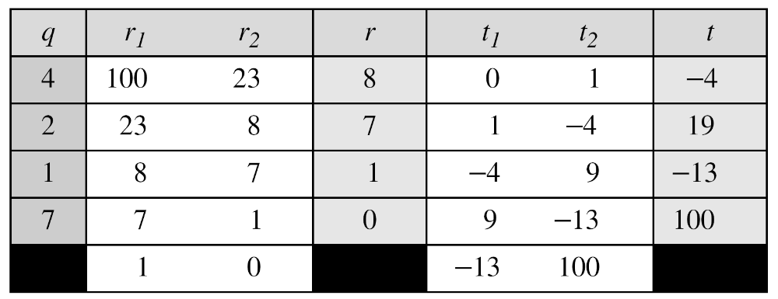
2.2.5 Continued
Example 2.26
Find the multiplicative inverse of 23 in Z₁₀₀.
Solution
The gcd (100, 23) is 1; the inverse of 23 is −13 or 87.
2.<number>

Slide 51
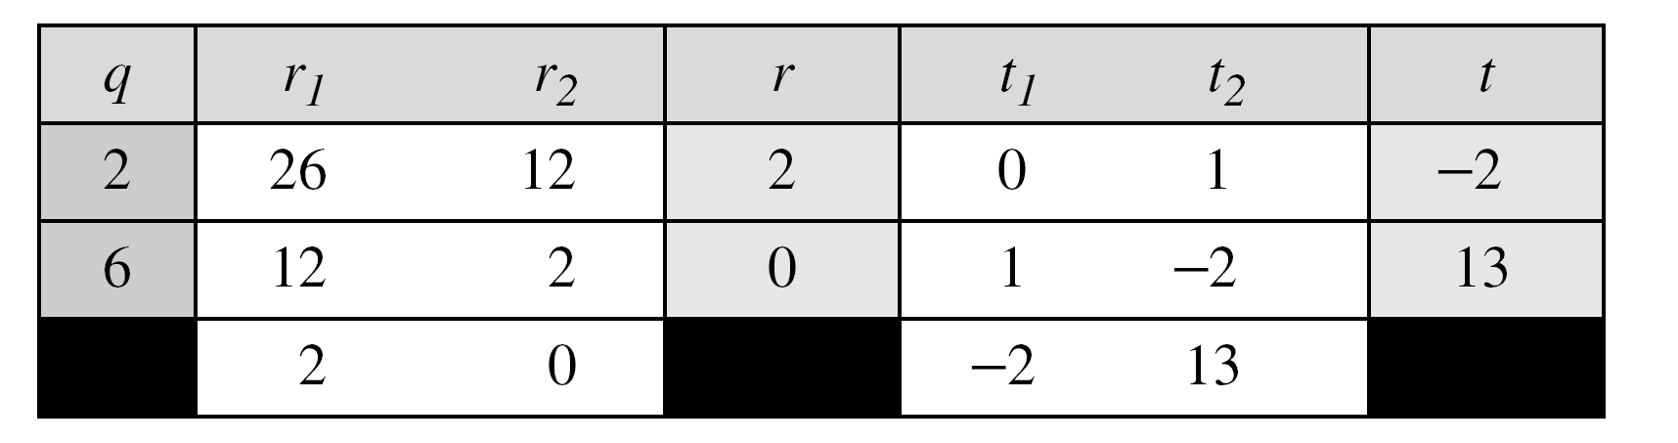
2.2.5 Continued
Example 2.27
Find the inverse of 12 in Z₂₆.
Solution
2.<number>

Slide 52
Module-III
Public Key Cryptography and RSA
Notes:
Opening quote.

Slide 53
Private-Key Cryptography
traditional private/secret/single key cryptography uses one key
shared by both sender and receiver
if this key is disclosed communications are compromised
also is symmetric, parties are equal
hence does not protect sender from receiver forging a message & claiming is sent by sender
Notes:
The development of public-key cryptography is the greatest and perhaps the only true revolution in the entire history of cryptography. From its earliest beginnings to modern times, virtually all cryptographic systems have been based on the elementary tools of substitution and permutation, and can be classed as private/secret/single key (symmetric) systems. All classical, and modern block and stream ciphers are of this form.

Slide 54
Public-Key Cryptography
probably most significant advance in the 3000 year history of cryptography
uses two keys – a public & a private key
asymmetric since parties are not equal
uses clever application of number theoretic concepts to function
complements rather than replaces private key crypto
Notes:
Will now discuss the radically different public key systems, in which two keys are used. Public-key cryptography provides a radical departure from all that has gone before. The development of public-key cryptography is the greatest and perhaps the only true revolution in the entire history of cryptography. It is asymmetric, involving the use of two separate keys, in contrast to symmetric encryption, that uses only one key. Anyone knowing the public key can encrypt messages or verify signatures, but cannot decrypt messages or create signatures, counter-intuitive though this may seem. The use of two keys has profound consequences in the areas of confidentiality, key distribution, and authentication. It works by the clever use of number theory problems that are easy one way but hard the other. Note that public key schemes are neither more nor less secure than private key (security depends on the key size for both), nor do they replace private key schemes (they are too slow to do so), rather they complement them. Both also have issues with key distribution, requiring the use of some suitable protocol.

Slide 55
Why Public-Key Cryptography?
developed to address two key issues:
  key distribution – how to have secure communications in general without having to trust a KDC with your key
  digital signatures – how to verify a message comes intact from the claimed sender
public invention due to Whitfield Diffie & Martin Hellman at Stanford Uni in 1976
  known earlier in classified community
Notes:
The concept of public-key cryptography evolved from an attempt to attack two of the most difficult problems associated with symmetric encryption: key distribution and digital signatures. The first problem is that of key distribution, which under symmetric encryption requires either (1) that two communicants already share a key, which somehow has been distributed to them; or (2) the use of a key distribution center. This seemed to negated the very essence of cryptography: the ability to maintain total secrecy over your own communication. The second was that of "digital signatures." If the use of cryptography was to become widespread, not just in military situations but for commercial and private purposes, then electronic messages and documents would need the equivalent of signatures used in paper documents.
The idea of public key schemes, and the first practical scheme, which was for key distribution only, was published in 1976 by Diffie & Hellman. The concept had been previously described in a classified report in 1970 by James Ellis (UK CESG) - and subsequently declassified [ELLI99]. Its interesting to note that they discovered RSA first, then Diffie-Hellman, opposite to the order of public discovery! There is also a claim that the NSA knew of the concept in the mid-60’s [SIMM93].

Slide 56
Public-Key Cryptography
public-key/two-key/asymmetric cryptography involves the use of two keys:
  a public-key, which may be known by anybody, and can be used to encrypt messages, and verify signatures
  a related private-key, known only to the recipient, used to decrypt messages, and sign (create) signatures
infeasible to determine private key from public
is asymmetric because
  those who encrypt messages or verify signatures cannot decrypt messages or create signatures
Notes:
Asymmetric algorithms rely on one key for encryption and a different but related key for decryption. These algorithms have the following important characteristic:
• It is computationally infeasible to determine the decryption key given only knowledge of the cryptographic algorithm and the encryption key.
In addition, some algorithms, such as RSA, also exhibit the following characteristic:
• Either of the two related keys can be used for encryption, with the other used for decryption.
Anyone knowing the public key can encrypt messages or verify signatures, but cannot decrypt messages or create signatures, thanks to some clever use of number theory.

Slide 57
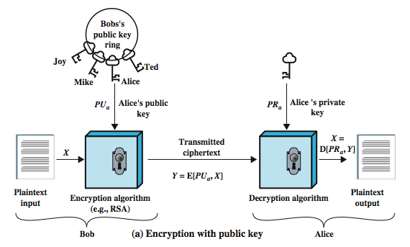
Public-Key Cryptography
Notes:
Stallings Figure 9.1a “Public-Key Cryptography”, shows that a public-key encryption scheme has six ingredients:
• Plaintext: the readable message /data fed into the algorithm as input.
• Encryption algorithm: performs various transformations on the plaintext.
• Public and private keys: a pair of keys selected so that if one is used for encryption, the other is used for decryption. The exact transformations performed by the algorithm depend on the public or private key that is provided as input.
• Ciphertext: the scrambled message produced as output. It depends on the plaintext and the key. For a given message, two different keys will produce two different ciphertexts.
• Decryption algorithm: accepts the ciphertext and matching key and produces the original plaintext.
Consider the following analogy using padlocked boxes: traditional schemes involve the sender putting a message in a box and locking it, sending that to the receiver, and somehow securely also sending them the key to unlock the box. The radical advance in public key schemes was to turn this around, the receiver sends an unlocked box (their public key) to the sender, who puts the message in the box and locks it (easy - and having locked it cannot get at the message), and sends the locked box to the receiver who can unlock it (also easy), having the (private) key. An attacker would have to pick the lock on the box (hard).

Slide 58
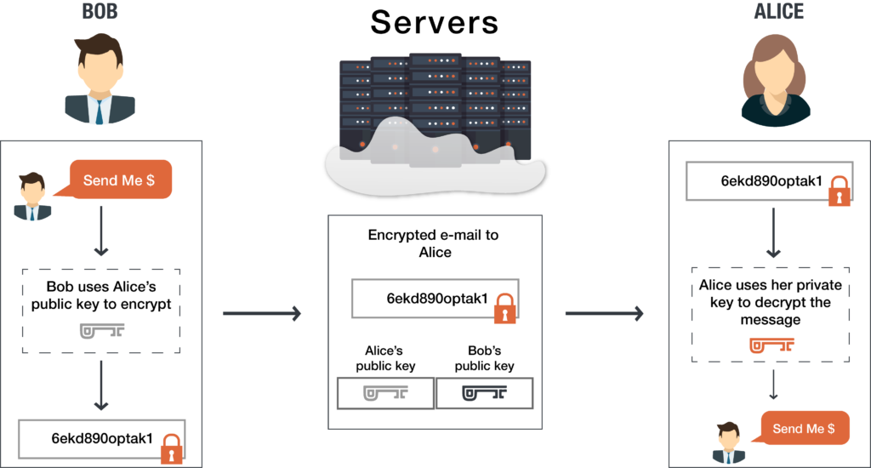
Asymmetric key cryptography

Slide 59
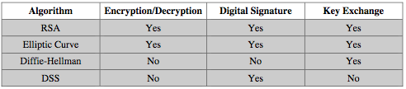
Public-Key Applications
can classify uses into 3 categories:
  encryption/decryption (provide secrecy)
  digital signatures (provide authentication)
  key exchange (of session keys)
some algorithms are suitable for all uses, others are specific to one
Notes:
Public-key systems are characterized by the use of a cryptographic type of algorithm with two keys. Depending on the application, the sender uses either the sender’s private key or the receiver’s public key, or both, to perform some type of cryptographic function. In broad terms, we can classify the use of public-key cryptosystems into the three categories:
• Encryption/decryption: The sender encrypts a message with the recipient’s public key.
• Digital signature: The sender “signs” a message with its private key, either to the whole message or to a small block of data that is a function of the message.
• Key exchange: Two sides cooperate to exchange a session key. Several different approaches are possible, involving the private key(s) of one or both parties.
Some algorithms are suitable for all three applications, whereas others can be used only for one or two of these applications. Stallings Table 9.3 (shown here) indicates the applications supported by the algorithms discussed in this book.

Slide 60
Public-Key Requirements
Public-Key algorithms rely on two keys where:
  it is computationally infeasible to find decryption key knowing only algorithm & encryption key
  it is computationally easy to en/decrypt messages when the relevant (en/decrypt) key is known
  either of the two related keys can be used for encryption, with the other used for decryption (for some algorithms)
Notes:
The cryptosystem illustrated in Figures 9.2 through 9.4 depends on a cryptographic algorithm based on two related keys. Diffie and Hellman postulated this system without demonstrating that such algorithms exist. However, they did lay out the conditions that such algorithms must fulfill:
It is computationally easy for a party B to generate a pair (public key PUb, private key PRb).
It is computationally easy for a sender A, knowing the public key and the message to be encrypted, M, to generate the corresponding ciphertext: C = E(PUb, M)
It is computationally easy for the receiver B to decrypt the resulting ciphertext using the private key to recover the original message: M = D(PRb, C) = D[PRb, E(PUb, M)
It is computationally infeasible for an adversary, knowing the public key, Pb, to determine the private key, PRb
It is computationally infeasible for an adversary, knowing the public key, Pb, and a ciphertext, C, to recover the original message, M.
(optional) The two keys can be applied in either order:
M = D[PU , E(PR, M)] = D[PR, E(PU, M)]
These are formidable requirements, as evidenced by the fact that only a few algorithms (RSA, elliptic curve cryptography, Diffie-Hellman, DSS) have received widespread acceptance in the several decades since the concept of public-key cryptography was proposed.

Slide 61
RSA
by Rivest, Shamir & Adleman of MIT in 1977
best known & widely used public-key scheme
uses large integers (eg. 1024 bits)
security due to cost of factoring large numbers
  factorization takes O(e ^{log n log log n}) operations (hard)
Notes:
RSA is the best known, and by far the most widely used general public key encryption algorithm, and was first published by Rivest, Shamir & Adleman of MIT in 1978 [RIVE78]. The Rivest-Shamir-Adleman (RSA) scheme has since that time reigned supreme as the most widely accepted and implemented general-purpose approach to public-key encryption. It is based on exponentiation in a finite (Galois) field over integers modulo a prime, using large integers (eg. 1024 bits). Its security is due to the cost of factoring large numbers.

Slide 62
RSA En/decryption
to encrypt a message M the sender:
  obtains public key of recipient PU={e,n}
  computes: C = Me mod n, where 0≤M<n
to decrypt the ciphertext C the owner:
  uses their private key PR={d,n}
  computes: M = C^{d} mod n
note that the message M must be smaller than the modulus n (block if needed)
Notes:
The scheme developed by Rivest, Shamir, and Adleman makes use of an expression with exponentials. Plaintext is encrypted in blocks, with each block having a binary value less than some number n. The actual RSA encryption and decryption computations are each simply a single exponentiation mod (n). Both sender and receiver must know the value of n. The sender knows the value of e, and only the receiver knows the value of d. Thus, this is a public-key encryption algorithm with a public key of PU = {e, n} and a private key of PR = {d, n}. Note that the message must be smaller than the modulus. The “magic” is in the choice of the modulus and exponents which makes the system work.

Slide 63
RSA Key Setup
each user generates a public/private key pair by:
selecting two large primes at random: p, q
computing their system modulus n=p.q
  note ø(n)=(p-1)(q-1)
selecting at random the encryption key e
  where 1<e<ø(n), gcd(e,ø(n))=1
solve following equation to find decryption key d
  e.d=1 mod ø(n) and 0≤d≤n
publish their public encryption key: PU={e,n}
keep secret private decryption key: PR={d,n}
Notes:
The required moduls and exponent values are chosen during key setup. RSA key setup is done once (rarely) when a user establishes (or replaces) their public key, using the steps as shown. The exponent e is usually fairly small, just must be relatively prime to ø(n). Need to compute its inverse mod ø(n) to find d. It is critically important that the factors p & q of the modulus n are kept secret, since if they become known, the system can be broken. Note that different users will have different moduli n.

Slide 64
RSA Example - Key Setup
Select primes: p=17 & q=11
Calculate n = pq =17 x 11=187
Calculate ø(n)=(p–1)(q-1)=16x10=160
Select e: gcd(e,160)=1; choose e=7
Determine d: de=1 mod 160 and d < 160 Value is d=23 since 23x7=161= 10x160+1
Publish public key PU={7,187}
Keep secret private key PR={23,187}
Notes:
Stallings provides an example of RSA key generation using “trivial” sized numbers.
Selecting primes requires the use of a primality test.
Finding d as inverse of e mod ø(n) requires use of Euclid’s Inverse algorithm (see Ch4)

Slide 65
RSA Example - En/Decryption
sample RSA encryption/decryption is:
given message M = 88 (nb. 88<187)
encryption:
  C = 88⁷ mod 187 = 11
decryption:
  M = 11²³ mod 187 = 88
Notes:
Then show that the encryption and decryption operations are simple exponentiations mod 187.
Rather than having to laborious repeatedly multiply, can use the "square and multiply" algorithm with modulo reductions to implement all exponentiations quickly and efficiently (see next).

Slide 66
RSA Key Generation
users of RSA must:
  determine two primes at random - p, q
  select either e or d and compute the other
primes p,q must not be easily derived from modulus n=p.q
  means must be sufficiently large
  typically guess and use probabilistic test
exponents e, d are inverses, so use Inverse algorithm to compute the other
Notes:
Before the application of the public-key cryptosystem, each participant must generate a pair of keys, which requires finding primes and computing inverses. Both the prime generation and the derivation of a suitable pair of inverse exponents may involve trying a number of alternatives. Typically make random guesses for a possible p or q, and check using a probabalistic primality test whether the guessed number is indeed prime. If not, try again. Note that the prime number theorem shows that the average number of guesses needed is not too large. Then compute decryption exponent d using Euclid’s Inverse Algorithm, which is quite efficient.

Slide 67
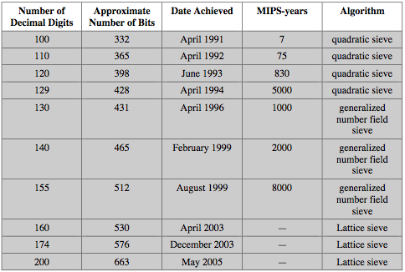
Progress in Factoring
Notes:
Stallings Table 9.5 shows the progress in factoring to date. The level of effort is measured in MIPS-years: a million-instructions-per-second processor running for one year, which is about 3 x 10¹³ instructions executed. A 1 GHz Pentium is about a 250-MIPS machine.

Slide 68
Summary
have considered:
  principles of public-key cryptography
  RSA algorithm, implementation, security
Notes:
Chapter 9 summary.

Slide 69
Key Management
Diffie-Hellman Key Exchange Algorithm
by
M.K.Chavan
Asst. Professor
Dept. of Computer Science

Slide 70
The Problem of Key Exchange
One of the main problems of symmetric key encryption is it requires a secure & reliable channel for the shared key exchange.
The Diffie-Hellman Key Exchange protocol offers a way in which a public channel can be used to create a confidential shared key.

Slide 71
Modular what?
In practice the shared encryption key relies on such complex concepts as Modular Exponentiation, Primitive Roots and Discrete Logarithm Problems.
Let’s see though is we can explain the Diffie-Hellman algorithm with no complex mathematics.

Slide 72
A Difficult One-Way Problem
The first thing we require is a simple real-world operation that is easy to Do but hard to Undo.
  You can ring a bell but not unring one.
  Toothpaste is easy to squeeze out of a tube but famously hard to put back in.
In our example we will use Mixing Colors.
  Easy to mix 2 colors, hard to unmix

Slide 73
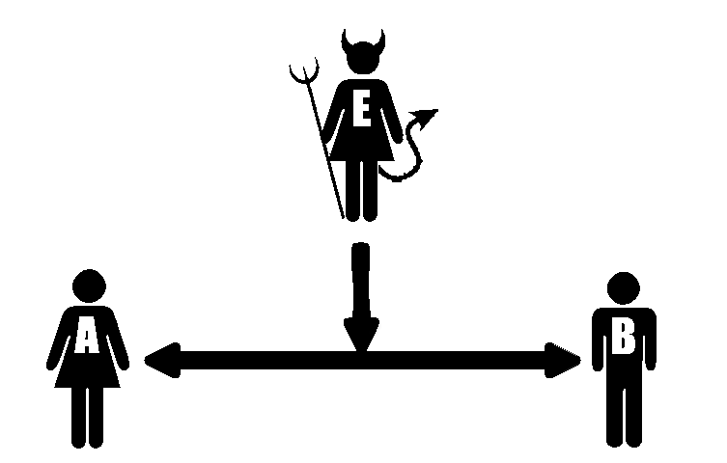
Alice & Bob with Eve listening wish to make a secret shared color

Slide 74
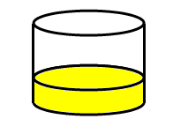
Step 1 - Both publicly agree to a shared color
Notes:
In step 1 Alice & Bob publicly agree on a shared color.
Notice as this is public that Eve is privy to the information as well.
In our example we will select Yellow as the shared color.

Slide 75
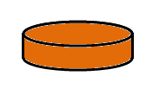

Step 2 - Each picks a secret color
Notes:
In step 2 each Alice & Bob select a secret color.
Neither knows of the other’s secret color as it is not shared.
Because they are not shared Eve has no opportunity to learn either’s secret color.
In our example Alice selects Orange for her secret color & Bob selects Teal for his secret color.

Slide 76
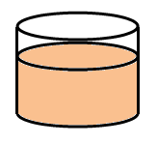


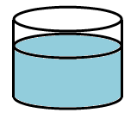
Step 3 - Each adds their secret color to the shared color
Notes:
In step 3 each takes their secret color and mixes it with the shared color.
In our example, to the shared Yellow:
Alice mixes her secret Orange to produce a Peach
Bob mixes his secret Teal to produce a Light blue

Slide 77
Step 4 - Each sends the other their new mixed color
Notes:
In step 4 each shares their mixture with the other.
Notice because the channel for sharing is not secure that Eve now knows the mixtures of each Alice & Bob.
Eve also knows the previously shared component of each mixture, Yellow, but not the secret color added by each.

Slide 78
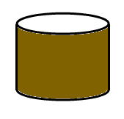


Each combines the shared color from the other with their own secret color
Notes:
And finally in step 5 the magic happens.
Each Alice & Bob combine the mixture received from the other with their own secret color.
This produces a new and identical mixture for each.
Notice without access to the secret color of either Alice or Bob that Eve is unable to perform this step.

Slide 79
Alice & Bob have agreed to a shared color unknown to Eve
How is it that Alice & Bob’s final mixtures are identical?
Alice mixed
  [(Yellow + Teal) from Bob] + Orange
Bob mixed
  [(Yellow + Orange) from Alice] + Teal
Notes:
Alice & Bob only performed the easy & trivial task of mixing colors.
Eve has no knowledge of the secret colors used by each Alice & Bob.
Eve is left with the difficult problem of unmixing colors.

Slide 80
Alice & Bob have agreed to a shared color unknown to Eve
How is it that Alice & Bob’s final mixture is secret?
Eve never has knowledge of the secret colors of either Alice or Bob
Unmixing a color into its component colors is a hard problem

Slide 81
Alice & Bob have agreed to a shared color unknown to Eve
How is it that Alice & Bob’s final mixture is secret?
Eve never has knowledge of the secret colors of either Alice or Bob
Unmixing a color into its component colors is a hard problem

Slide 82
Diffie-Hellman Key Exchange
first public-key type scheme proposed
  For key distribution only
by Diffie & Hellman in 1976 along with the exposition of public key concepts
  note: now know that James Ellis (UK CESG) secretly proposed the concept in 1970
is a practical method for public exchange of a secret key
used in a number of commercial products
Notes:
The idea of public key schemes, and the first practical scheme, which was for key distribution only, was published in 1977 by Diffie & Hellman. The concept had been previously described in a classified report in 1970 by James Ellis (UK CESG) - and subsequently declassified in 1987. See History of Non-secret Encryption (at CESG).

Slide 83
Diffie-Hellman Setup
all users agree on global parameters:
  large prime integer or polynomial q
  α a primitive root mod q
each user (eg. A) generates their key
  chooses a secret key (number): x_{A} < q
  compute their public key: y_{A} = α^{xA} mod q
each user makes public that key y_{A}
Notes:
The prime q and primitive root α can be common to all using some instance of the D-H scheme. Note that the primitive root α is a number whose powers successively generate all the elements mod q. Alice and Bob choose random secrets x's, and then "protect" them using exponentiation to create the y's. For an attacker monitoring the exchange of the y's to recover either of the x's, they'd need to solve the discrete logarithm problem, which is hard.

Slide 84
Diffie-Hellman Key Exchange
shared session key for users A & B is K:
  K = y_{A}^{xB} mod q (which B can compute)
  K = y_{B}^{xA} mod q (which A can compute)
  (example)
K is used as session key in private-key encryption scheme between Alice and Bob
if Alice and Bob subsequently communicate, they will have the same key as before, unless they choose new public-keys
attacker needs an x, must solve discrete log
Notes:
The actual key exchange for either party consists of raising the others "public key' to power of their private key. The resulting number (or as much of as is necessary) is used as the key for a block cipher or other private key scheme. For an attacker to obtain the same value they need at least one of the secret numbers, which means solving a discrete log, which is computationally infeasible given large enough numbers

Slide 85
Diffie-Hellman Example
users Alice & Bob who wish to swap keys:
agree on prime q=353 and α=3
select random secret keys:
  A chooses x_{A}=97, B chooses x_{B}=233
compute public keys:
  y_{A}=3⁹⁷ mod 353 = 40 (Alice)
  y_{B}=3²³³ mod 353 = 248 (Bob)
compute shared session key as:
  K_{AB}= y_{B}^{xA} mod 353 = 248⁹⁷ = 160 (Alice)
  K_{AB}= y_{A}^{xB} mod 353 = 40²³³ = 160 (Bob)

Slide 86
Reference
Cryptography and Network Security Principles and Practices, William Stallings,4th Edition.

